Slide 1
November 2023 Annual General Meeting
Southeast Wisconsin IIBA Chapter © 2023 wisconsin.iiba.org

Slide 2
Thank you to all of our Chapter sponsors…
Platinum sponsor
Southeast Wisconsin IIBA Chapter © 2023 wisconsin.iiba.org

Slide 3
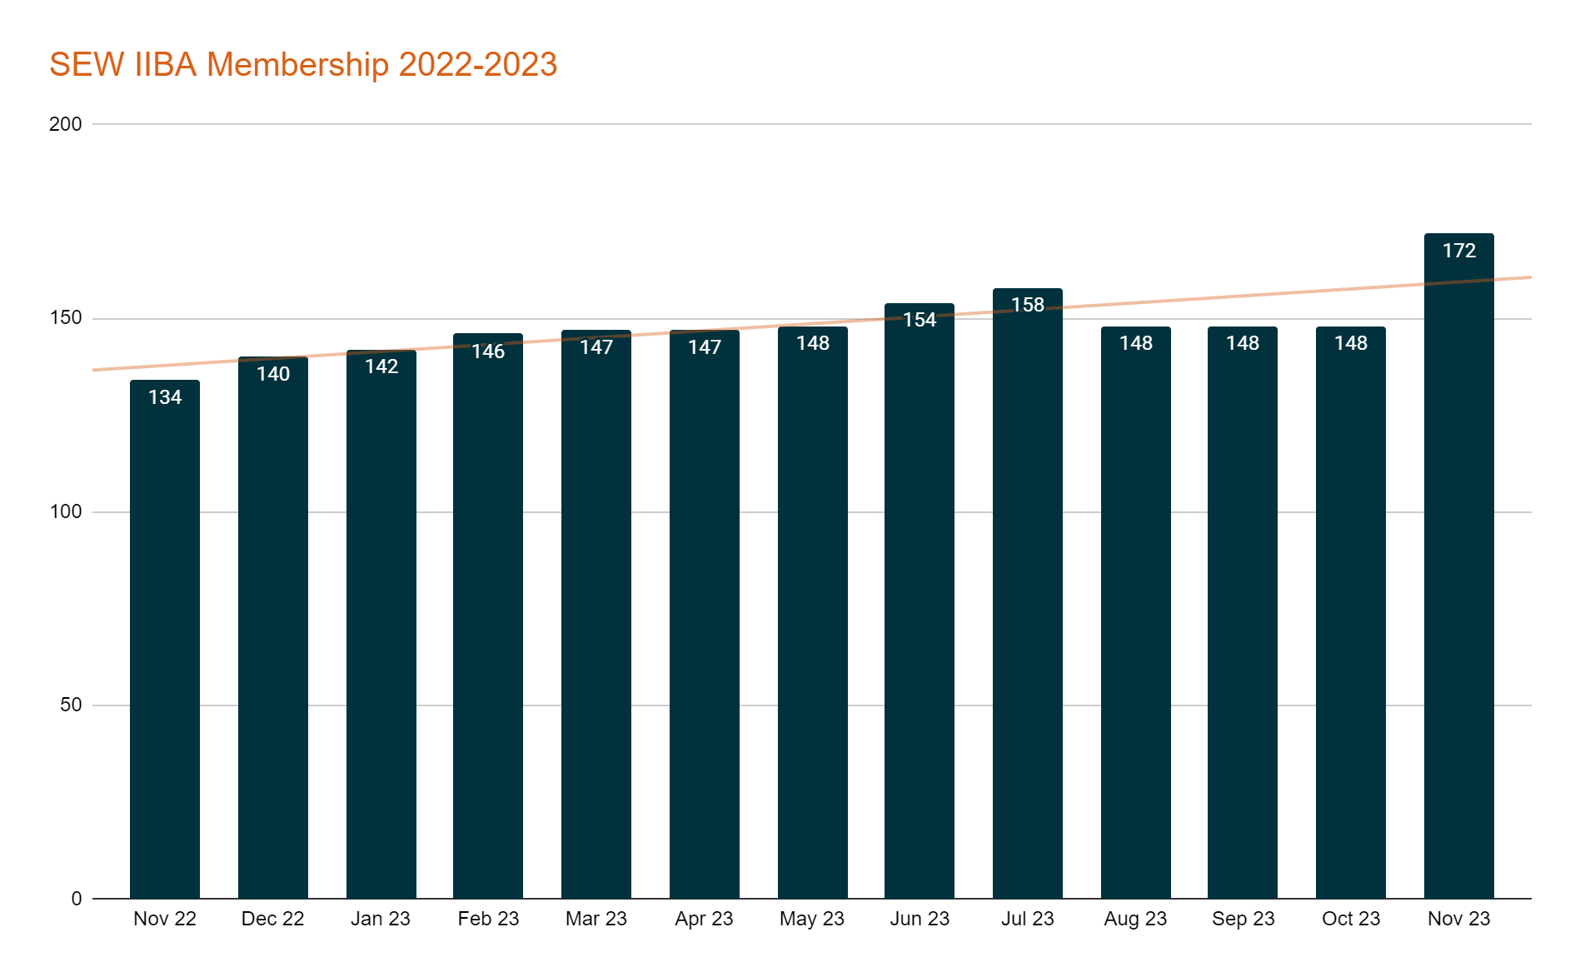
Membership Recap
Southeast Wisconsin IIBA Chapter © 2023 wisconsin.iiba.org

Slide 4
Meetings/Attendance
September Chapter Meeting:
Format: Hybrid
Topic: Defeat the Meeting Super Villains
Presenter: Dave Saboe
Attendance:
Members: 19
Non-Members: 3
**Due to having a light Chapter Board
there was only one chapter meeting
scheduled in September. Please reach
out if you are interested in joining the Board!
Southeast Wisconsin IIBA Chapter © 2023 wisconsin.iiba.org

Slide 5
Education Recap
Congratulations to our 2023 Certificate earners!
Amanda Conway - CBAP
Eleonore Molstad - ECBA & CCBA
Jeremy Schraufnagel - CCBA (Dec 2022)
Rachel Holmaas - ECBA
Kyle Bohmsach - ECBA & Agile Analysis
Michelle Foxen - CPOA
Koryn Anderson - CPOA
Tess Olson - CPOA
Amanda Roehl - CBDA
Heidi Sehmer - Agile Analysis
Southeast Wisconsin IIBA Chapter © 2023 wisconsin.iiba.org

Slide 6
Technology and Communications Recap
LinkedIn
Refocusing connections on Wisconsin BAs, recruiters, and sponsors for membership
Inviting 2nd and 3rd level connections
Adding relevant content feeds
Posting events and other info
Mailchimp and Eventbrite
Emailing for events with follow-ups
Monitoring tickets and informing to rest of board
IIBA Chapter site
Populating events calendar
Posting news items
Investigating ways to hide static Twitter feed for interim
Southeast Wisconsin IIBA Chapter © 2023 wisconsin.iiba.org

Slide 7
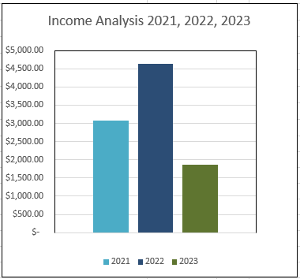
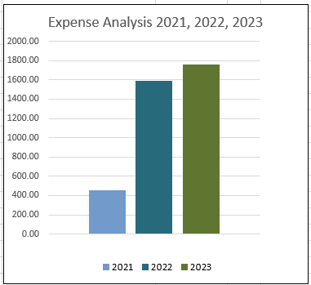
2023 Finance Year End Report
Managed the finances and balanced the budget
Continued to have low expenses due having only 1 meeting and our AGM.
*2021 income here does not include additional funds from closure of Madison Chapter and WIBADD
Southeast Wisconsin IIBA Chapter © 2023 wisconsin.iiba.org

Slide 8
Job Opportunities
Are you in need of a new opportunity?
Is your company currently looking for qualified BA’s?
Southeast Wisconsin IIBA Chapter © 2022 wisconsin.iiba.org

Slide 9
2024 1st Quarter Events – Virtual Events
Because we’re in Wisconsin and, you know, snow
January 23rd - Susan Moore
Value of IIBA Membership
Free to Everyone!
February 27th - Judy Alter
Case for Business Analyst on an Agile Team
March 19th - Lawrence Reid
ChatGPT and How it will Impact Business Analysis
Southeast Wisconsin IIBA Chapter © 2022 wisconsin.iiba.org

Slide 10
2024 2nd Quarter Events
TBD - At least 1 Hybrid Educational Event
3 In-Person Networking Events
One in Milwaukee Area
One in Madison Area
One in Appleton/Green Bay Area
Looking for volunteers to scout places and spread the word about!
Southeast Wisconsin IIBA Chapter © 2022 wisconsin.iiba.org

